Slide 1

UNDERSTANDING STATISTICAL MEASURES
Group Task Presentation
Anxiety attack analysis
group members: Nitin, Prachi, Harleen

Slide 2

Introduction
Statistical measures summarize and describe datasets.
They help understand central tendency, spread, and relationships in data.
Common types:
Measures of Central Tendency: Mean, Median, Mode (center of the data)
Measures of Dispersion: Range, Variance, Standard Deviation (spread of the data)
Measures of Shape: Skewness, Kurtosis (symmetry and peak of the data)

Slide 3
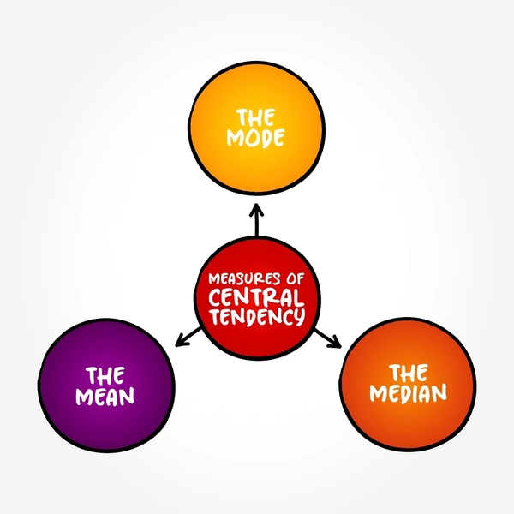
Measure of Central Tendency
A single value that represents or describes all the data.

Slide 4
Mean
Definition: The mathematical average of a data.
1
Formula: Mean = ΣX / n
ΣX of a data set is the sum of all the data divided by the count n.
2
Importance: It condenses a large amount of data into a single value, making it easier to communicate and interpret the results.
3
When to use: It’s best to use when the distribution of dataset is mostly symmetrical and there are no outliers.
4
Example: Average Sleep Hours in the dataset to analyze sleeping patterns among individuals with anxiety.
5
Mean Sleep Hours=
(∑Sleep Hours of all individuals​)
÷
(Total number of individuals)
6

Slide 5
Mean
Interpreting the result:
If the mean sleep hours are low (e.g., below 6 hours), it may suggest that anxiety is linked to sleep deprivation.
If the mean is within the normal range (7-9 hours), other factors might be influencing anxiety attacks.
If there is high variance, some individuals might be getting too little sleep while others sleep excessively, indicating inconsistent sleep patterns.

Slide 6
Median
Definition: The middle value when data is ordered
Formula: Median = X(n+1)/2 ; (for odd n)
Importance: Useful when data has outliers.
When to use: It is preferred if the data is a string(object) or numeric.
Example: Median Stress Level from the dataset to determine typical stress levels.

Slide 7



Example Dataset
Stress Levels: [2, 3, 4, 5, 6, 7, 8, 9, 10] (Odd count)
n=9 (odd)
Using the formula:
Median=X((9+1)/2)=X5
The 5th value is 6, so the median stress level = 6.

Slide 8
Mode
Definition: The most frequently occurring value
Formula: Mode=Xmax(f)​
Importance: Useful for categorical data analysis
When to use: Identifying the most common category
Example: Most common Smoking status (Yes/No) among individuals.

Slide 9
Applying the Formula to "Smoking Status" Column
Let's assume the dataset contains the following Smoking Status responses:
Step 1: Identify unique values: Yes, No
Step 2: Count the frequency of each:
"Yes" appears 40 times
"No" appears 60 times
Step 3: The mode is the value with the highest frequency:
Mode="No"
So, the most common smoking status in the dataset is "No", meaning most individuals in the dataset do not smoke.

Slide 10

Mode
. Why is Mode Useful in Smoking Analysis?
Identifies the most common behavior among individuals with anxiety.
Helps researchers analyze the impact of smoking on anxiety attacks.
If the mode is "Yes," it may indicate a link between smoking and anxiety.
If the mode is "No," it suggests that most individuals do not smoke, so other factors influence anxiety.

Slide 11
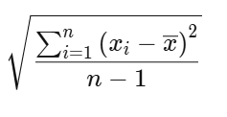
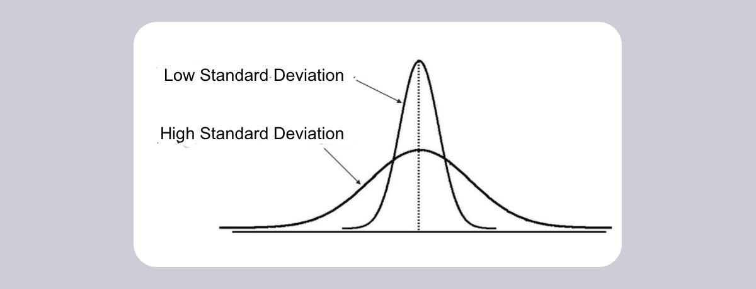
Standard Deviation
Definition: a measure of how dispersed the data is in relation to the mean.
Formula: σ =
Importance: Helps understand data consistency or the amount of data variation.
When to use: To describe the spread of their data and to identify outliers.
Example: Standard deviation of Heart Rate during anxiety attacks.

Slide 12
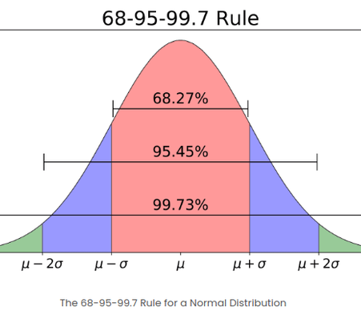
Example
Heart Rate Data (BPM)
110, 115, 108, 120, 112
Steps to Calculate Standard Deviation:
Mean (Average): (110 + 115 + 108 + 120 + 112) / 5 = 113 BPM
Deviation from Mean: (-3, 2, -5, 7, -1)
Squared Deviations: (9, 4, 25, 49, 1)
Sum of Squared Deviations: 9 + 4 + 25 + 49 + 1 = 88
Standard Deviation: √(88 / 5) ≈ 4.2 BPM
The heart rate fluctuates by ±4.2 BPM around the mean of 113 BPM.
Helps understand heart rate variability during anxiety episodes.

Slide 13
Variance
Definition:
Variance is a statistical measurement used to determine how far each number is from the mean and every other number in the set.
Formula:
σ² = Σ(X - μ)² / n
Importance:
Helps in probability modeling
When to use:
Use Variance when performing theoretical or mathematical analyses, as it’s easier for calculations and models.
Quality Control & Process Improvement
Example:
Variance in Physical Activity Hours to assess exercise habits.

Slide 14
Understanding Variance in Exercise Habits
Example: Weekly Exercise Hours
Person A: 2 hrs, B: 5 hrs, C: 3 hrs, D: 6 hrs, E: 4 hrs
Mean (Average) = 4 hrs
Variance Calculation:
Find differences from the mean:
(2-4) = -2, (5-4) = 1, (3-4) = -1, (6-4) = 2, (4-4) = 0
Square the differences:
(-2)² = 4, (1)² = 1, (-1)² = 1, (2)² = 4, (0)² = 0
Find the average of squared values:
(4+1+1+4+0) / 5 = 2
Interpretation: A variance of 2 hours² means individuals have different exercise habits.
A higher variance suggests inconsistency in workout routines.

Slide 15
(Measure of Shape)
Measures of shape are statistical tools used to describe the distribution of data in a dataset

Slide 16
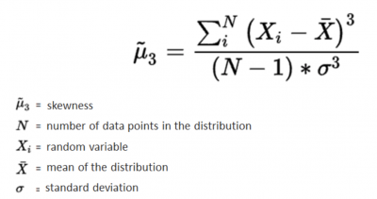
Skewness (Measure of Shape)
Definition: Skewness tells us which side a data distribution is stretched. It shows whether most values are clustered to the left, right, or evenly spread around the middle (mean).
Formula: Skewness=[n/(n−1)(n−2)]∑(xi−xˉ/σ)^3
n: Number of observations.
xi: Data points.
xˉ: Mean.
σ: Standard deviation.
Imporance:
Identifies symmetry or asymmetry.
Detects outliers.
Validates normality for statistical models.
Assesses risk in finance.
When to Use:
Exploratory Data Analysis (EDA).
Before applying statistical tests.
Financial risk analysis.
Data transformation.

Slide 17
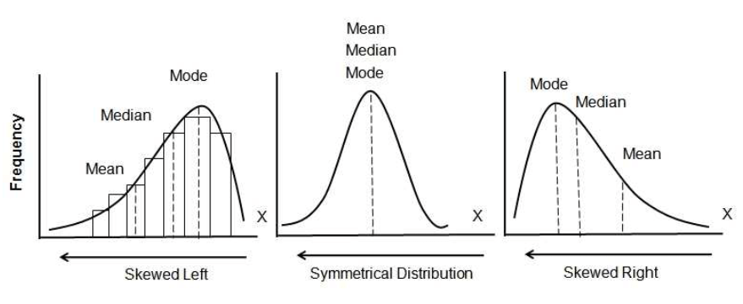
Skewness
Interpretation:
Positive Skewness: The right tail is longer or fatter than the left. The mass of the distribution is concentrated on the left.
Negative Skewness: The left tail is longer or fatter than the right. The mass of the distribution is concentrated on the right.
Zero Skewness: The distribution is symmetric.

Slide 18
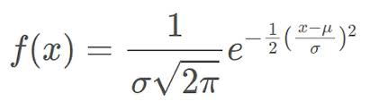
Skewness
Imagine we have recorded the durations (in minutes) of anxiety attacks for a group of individuals:
Durations=[5,7,8,10,12,15,20,30,45,60]
Step 1: Calculate the Mean xˉ=∑xi/n=(5+7+8+10+12+15+20+30+45+60)/10=212/10=21.2
Step 2: Calculate the Standard Deviation (σ)
σ=16.9
Step 3: Compute Skewness
​After calculations, the skewness value is positive (approximately 1.2), indicating a right-skewed distribution.

Slide 19

Skewness
Interpretation in Terms of Anxiety Attacks
Since skewness > 0, the data is positively skewed.
This means most anxiety attacks are shorter, but a few long-lasting episodes (e.g., 45 min, 60 min) pull the distribution to the right.
The long tail suggests that while most people experience brief anxiety attacks, some experience significantly longer episodes

Slide 20
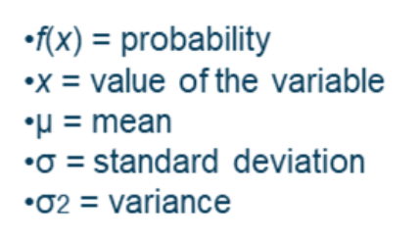
Distribution
Distribution refers to how the values of a random variable are spread or arranged across possible outcomes. It shows the probability or frequency of each possible outcome in a given set of data.
Formula:
Normal Distribution:
Bell-shaped, symmetric curve.
Mean = Median = Mode.
Example: Heights, test scores.
Uniform Distribution:
Equal probability for all outcomes.
Example: Rolling a fair die.
Binomial Distribution:
Models successes in fixed trials.
Example: Coin flips, quality tests.
Exponential Distribution:
Models time between independent events.
Example: Waiting times, machine lifespan

Slide 21
Distribution
When to Use a Distribution?
Understand Data: Identify patterns, spread, and trends.
Predict Outcomes: Use probability distributions for forecasting.
Hypothesis Testing: Check if data fits a distribution.
Risk Assessment: Estimate probabilities in uncertain scenarios.
Data Modeling: Build models for simulations and forecasting.
Importance of Distribution
Distributions reveal how data is spread across different values.
They help predict future outcomes based on past data.
Distributions are key for statistical testing and hypothesis validation.
They assist in identifying outliers or unusual data points.
Proper understanding enables accurate modeling of real-world processes

Slide 22
Distribution
Example of Normal Distribution - Anxiety Scores
Scenario:
A researcher surveys 500 individuals to measure anxiety levels (0-100 scale).
The data follows a Normal Distribution with:
Mean Anxiety Score (μ) = 50
Standard Deviation (σ) = 15
Key Insights:
Most individuals' anxiety scores are close to 50.
Scores decrease as they approach the extremes (0 or 100).
68% of scores fall between 35 and 65 (within one standard deviation from the mean).
Visual:
Include a bell curve representing the normal distribution with the peak at 50 and the standard deviation marked at 35 and 65

Slide 23
Conclusion
Statistical measures are key in understanding data and making decisions in AI and Machine Learning.
They help us find patterns, predict outcomes, and improve models.
By analyzing data’s center, spread, and shape, we can build more accurate and efficient algorithms

